Slide 1
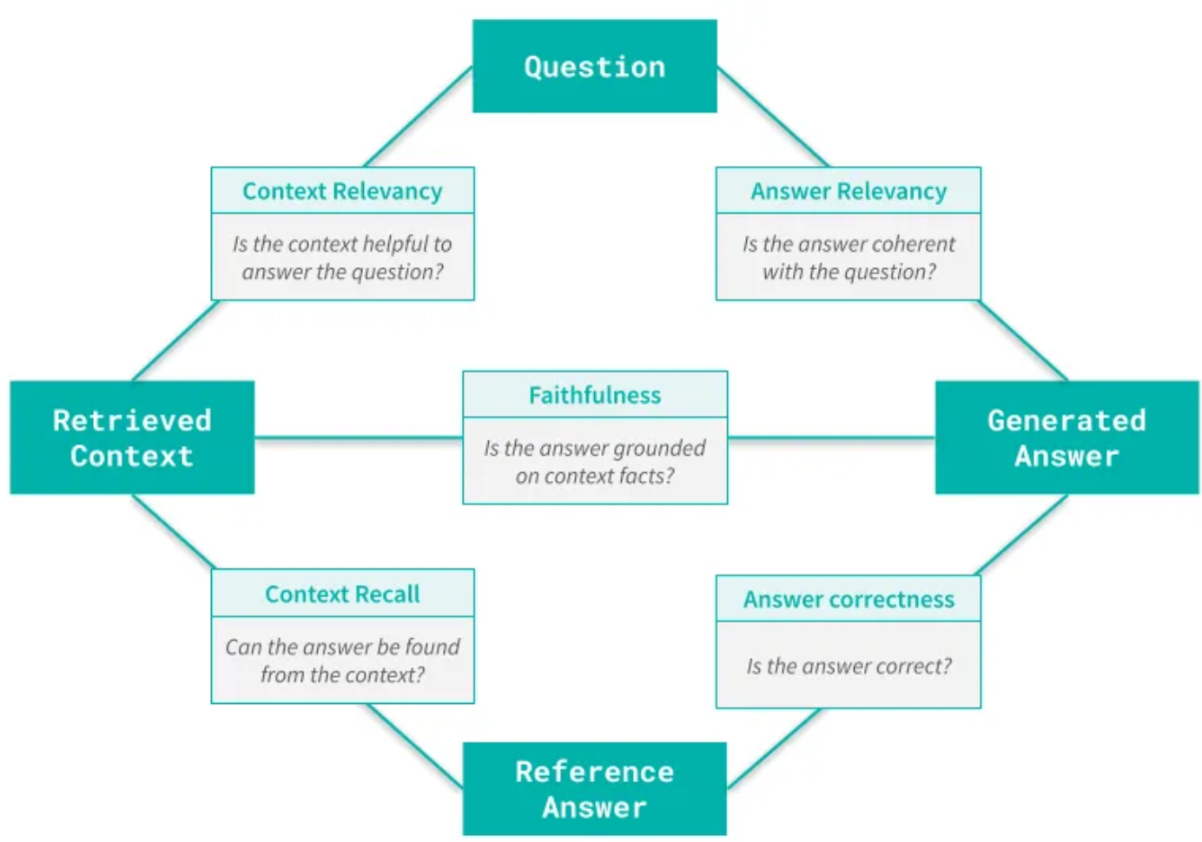
RAG Evaluation Framework: A Strategic Journey for AI Excellence
A comprehensive system for ensuring accurate, reliable, and high-quality AI performance across an enterprise

Slide 2
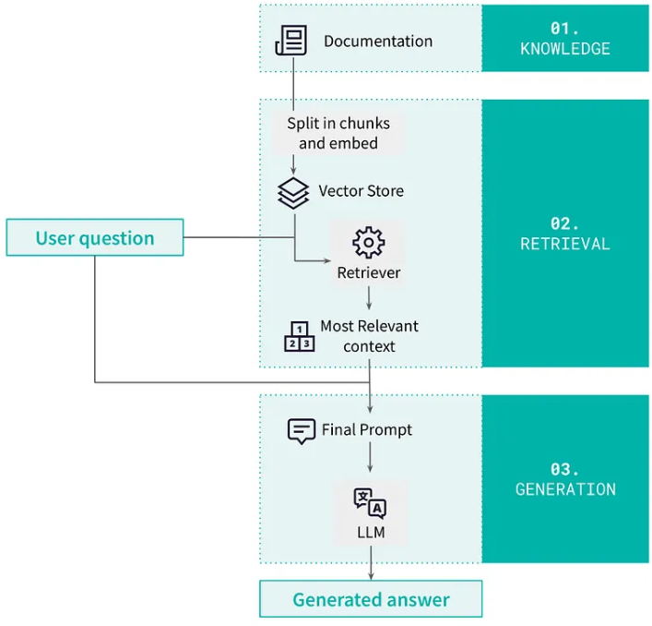



The Challenge: Why We Need RAG Evaluation
RAG Building Blocks
The Reality of AI in Business
Where This Matters Most
What Everyone Expects from Our AI
We're using AI systems across our company, but we have a big problem: How do we know if our AI is giving correct and reliable answers?
Banking, Customer Support, Healthcare, Legal Work - wrong information could cost millions, upset customers, harm people, and create liability risks
Correct Information, Relevant Responses, Consistent Quality, Provable Results - we need to grow AI use while keeping quality high
The key question is how do we ensure the quality and reliability of our AI systems as we expand their use across the enterprise?

Slide 3




The Risks: What Could Go Wrong Without Evaluation
Problem 1
Regulatory Trouble: $50M+ in fines, loss of trust, months of repairs
Problem 3
Slow Quality Loss: Gradual decline, hard to detect, costly to fix
Bigger Picture
Problem 2
Problems spread across AI systems, inability to prove compliance
Unhappy Customers: Angry reviews, lost sales, manual fixes

Slide 4
Our Solution: How We Built a Revolutionary RAG Evaluation Framework
Comprehensive Metrics: What We Measure
Three-Tiered Evaluation Architecture
Guarantees assessment under any conditions - from optimal performance to complete system failures
RAGAS Evaluation - The Gold Standard
Uses advanced AI models for intelligent analysis, component breakdown, semantic understanding, and comprehensive scoring
LLM-as-a-Judge - Human-Like Intelligence
AI-powered evaluation system that mimics expert human judgment when primary evaluation fails
Faithfulness
Measures factual consistency with source documents. Prevents misinformation and hallucinations.
Answer Relevancy
Measures how directly the response addresses the user's question. Improves user satisfaction and task completion.
Context Precision
Measures relevance and focus of retrieved information. Ensures AI uses appropriate source material.
ML-Based Scoring - Guaranteed Reliability
Statistical analysis, lexical comparison, and local processing to ensure evaluation completion regardless of external dependencies
Comprehensive Metrics: The Five Pillars of AI Quality
Faithfulness, Answer Relevancy, Context Precision, Context Recall, and Answer Correctness
Advanced Capabilities: Real-Time Production Monitoring, Custom Evaluation Testing, and Advanced Analytics & Visualization
Enabling immediate issue detection, pre-deployment validation, and data-driven decision making
Context Recall
Measures completeness of information retrieval. Prevents critical information gaps.
Answer Correctness
Measures overall accuracy against established ground truth. Validates response quality against known correct answers.

Slide 5
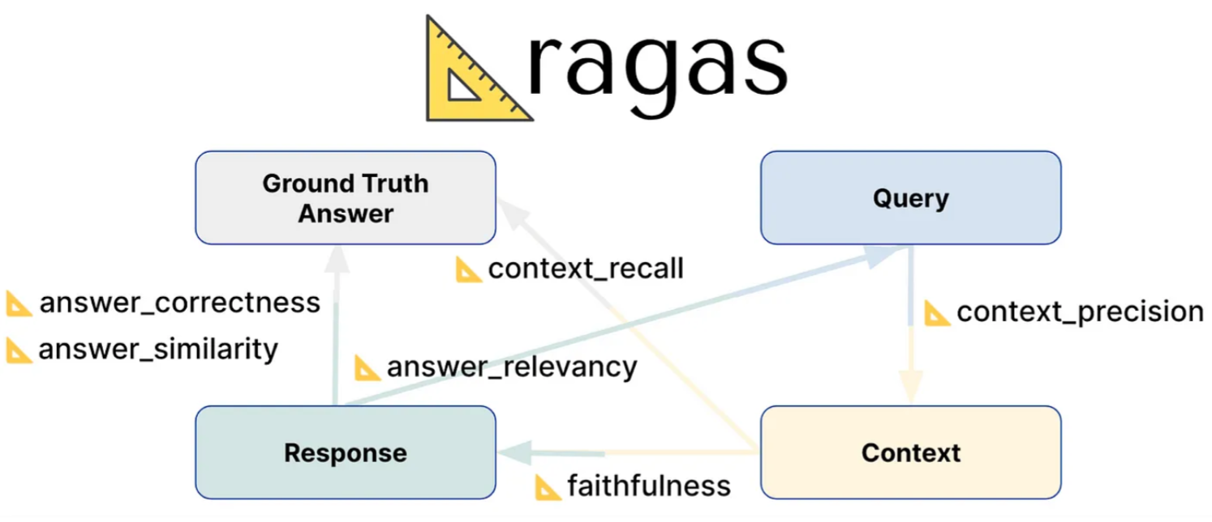
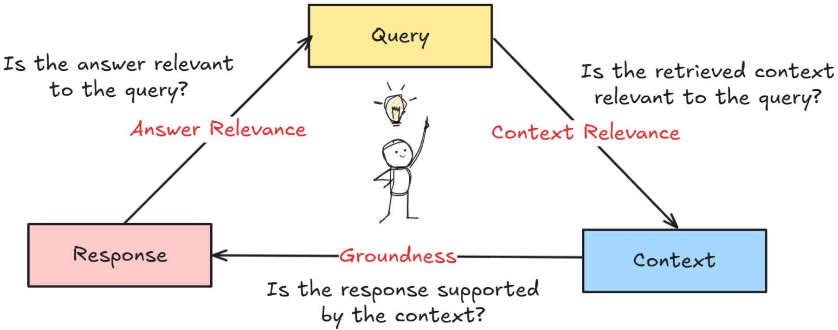
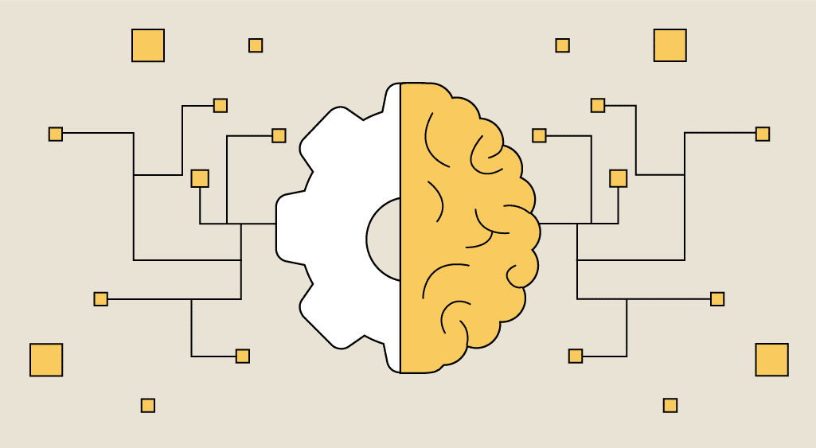
Three-tiered evaluation architecture
RAGAS Evaluation
The RAGAS Evaluation Framework is a comprehensive and advanced system for assessing the quality and reliability of AI systems. It employs a three-tiered approach, including research-grade RAGAS evaluation, human-like LLM-as-a-Judge assessment, and guaranteed ML-based scoring, to ensure AI performance meets the highest standards across critical metrics like faithfulness, answer relevancy, context precision, context recall, and answer correctness.
LLM-as-a-Judge - Human-Like Intelligence
The LLM-as-a-Judge system is an AI-powered evaluation framework that mimics expert human judgment when primary evaluation methods fail. It utilizes intelligent prompting, contextual reasoning, and explanatory scoring to provide nuanced, adaptive assessment of AI responses, ensuring high-quality evaluation even during system disruptions.
ML-Based Scoring - Guaranteed Reliability
The ML-Based Scoring tier of the RAG Evaluation Framework provides a guaranteed reliability mechanism to ensure evaluation completion under any circumstances. This mathematical text analysis system leverages statistical techniques like TF-IDF vectorization and cosine similarity calculations to assess response quality, without relying on external APIs or dependencies.

Slide 6
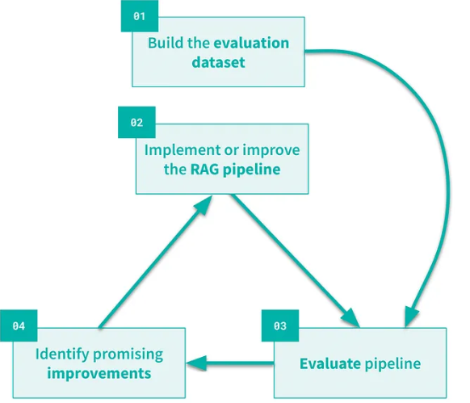



Advanced Capabilities: What Makes Our Framework Unique
Continuous Improvement
Real-Time Production Monitoring
Custom Evaluation Testing
Advanced Analytics & Visualization
Live system integration, real-time capture of user interactions and AI responses, continuous assessment, and time-based analysis for immediate detection of performance issues.
Controlled assessment environment with custom datasets, model comparison, pre-deployment validation, and scenario testing for risk mitigation and informed decision-making.
Executive dashboard with real-time gauges, trend analysis, drill-down capability, correlation analysis, and automated alerting for data-driven decision making and early warning.
Our advanced capabilities transform AI evaluation from a technical challenge into a strategic advantage, enabling confident AI deployment, superior performance, and enterprise-wide transformation.

Slide 7
Business Benefits
99.9% Evaluation Availability
Three-tier system ensures continuous monitoring
Zero False Negatives
Critical issues never go undetected
Compliance Confidence
Audit-ready documentation and transparent evaluation
Reputation Protection
Proactive quality assurance prevents customer-facing failures
Automated Quality Assurance
Reduced manual review requirements by 80%
Faster Issue Resolution
Average detection time reduced from days to minutes
Cost Optimization
Data-driven model selection saves 30% on AI infrastructure costs
Improved User Satisfaction
Measurable improvement in response quality and relevance

Slide 8



Universal Adoption: How Other Programs Can Implement This Framework
Configuration-Driven Advantage
Rapid Deployment Process
Immediate Adoption Candidates
Simple JSON configuration, template selection, and metric customization to set up the evaluation framework in 1-2 days.
Universal framework that adapts to any business need through simple configuration, instead of building custom evaluation systems for each program.
High-impact programs like HR systems, IT helpdesk, sales support, procurement, and risk management are ready for rapid deployment.
The configuration-driven approach enables rapid enterprise-wide expansion of the evaluation framework, transforming AI risk into AI confidence across the organization.

Slide 9
Appendix

Slide 10
The Expansion Opportunity: Enterprise-Wide Transformation
Immediate Adoption Candidates
High-Impact Programs Ready for Deployment: HR Systems, IT Helpdesk, Sales Support, Procurement, Risk Management
HR Systems
Employee query accuracy and policy compliance
IT Helpdesk
Technical support response quality
Sales Support
Product information accuracy and consistency
Procurement
Vendor evaluation and compliance checking
Risk Management
Risk assessment AI validation

Slide 11
Advanced Capabilities: What Makes Our Framework Unique
Real-Time Production Monitoring
Custom Evaluation Testing
Advanced Analytics & Visualization
Controlled assessment environment with custom datasets, model comparison, pre-deployment validation, and scenario testing for risk mitigation and informed decision-making.
Live system integration, real-time capture of user interactions and AI responses, continuous assessment, and time-based analysis for immediate detection of performance issues.
Executive dashboard with real-time gauges, trend analysis, drill-down capability, correlation analysis, and automated alerting for data-driven decision making and early warning.
Our advanced capabilities transform AI evaluation from a technical challenge into a strategic advantage, enabling confident AI deployment, superior performance, and enterprise-wide transformation.

Slide 12
The Challenge: Why We Need RAG Evaluation
The Reality of AI in Business
Where This Matters Most
What Everyone Expects from Our AI
We're using AI systems across our company, but we have a big problem: How do we know if our AI is giving correct and reliable answers?
Banking, Customer Support, Healthcare, Legal Work - wrong information could cost millions, upset customers, harm people, and create liability risks
Correct Information, Relevant Responses, Consistent Quality, Provable Results - we need to grow AI use while keeping quality high
The key question is how do we ensure the quality and reliability of our AI systems as we expand their use across the enterprise?

